Slide 1
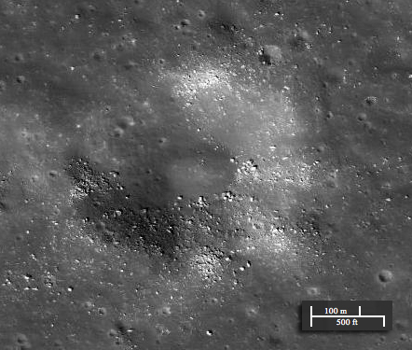


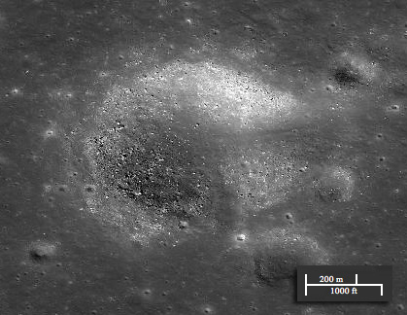
Craters in Younger Lunar Mare Units Seen in LROC NAC Images
Hallie Gengl
Mark Robinson
Ernest Bowan-Ciscneros
Reinhold Povilaitis
Space Grant Symposium 2012
April 21, 2012
Notes:
For many years now there has been research into interesting mare craters on the lunar surface. Greeley had published a paper about ringed moat features remnants from mare flows. Since the Lunar Reconaissance Orbiter Camera has been in orbit now we can see the detail down to boulders in mare craters. Throughout the different mare units craters that looked like this were showing up everywhere, but there characteristics were not understood. On the right this is my favorite example, you can clearly see a flow pattern into the crater. This would lead me to believe by the law of superposition the flow came second.

Slide 2
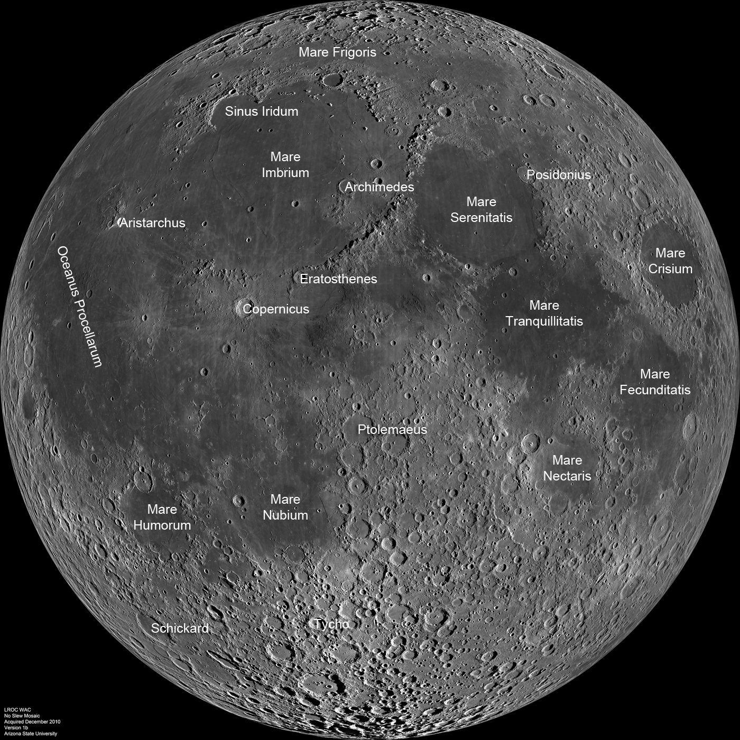
Objective
Using LROC NAC images, study the distribution and characterization of boulder rich craters in Mare Crisium to study their origins
Lunar Nearside WAC Mosaic. NASA/ASU/LRO
Notes:
Study distribution within unit
Characterization of the individual craters with these boulders
Mare crisium as first start
Learn about their origins

Slide 3
Background
Younger mare flows have covered much of the older terrain on the lunar nearside leaving only a small number of aged craters visible in these regions.
Learn:
timeline of Mare emplacement
possible characteristics of these mare flows.
Notes:
Younger flows have covered older terrain

Slide 4
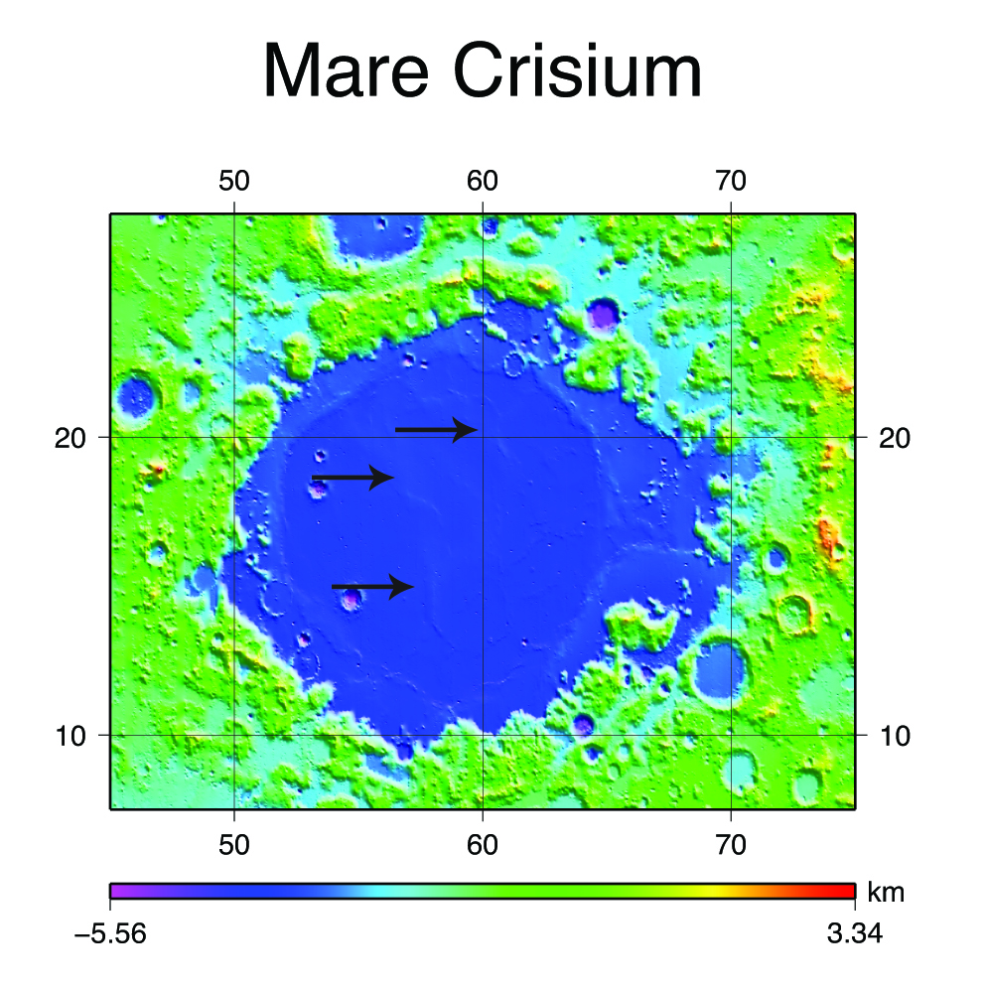
Mare Crisium
Mare Crisium is a Nectarian aged basin that spans 740 km.
LOLA data show that the floor of Mare Crisium is approximately 1.8 km below lunar datum, or "sea level," while the outer rim is about 3.34 km above lunar datum.
NASA/LRO/LOLA
Notes:
~3.18 b.y. to 3.28 b.y. with one younger sample L24-5 at ~2.8 b.y

Slide 5
Approach
Used ACT REACT Quick Map to look through ~1000 Narrow Angle Camera (NAC) images finding “bouldery” craters
Completed full distribution of aged “bouldery” craters in Mare Crisium in ACT REACT.
Created a classification scheme for these craters
Notes:
Created image catalogue
Scanned through each image 1-2 meters per pixel resolution

Slide 6
Classification Scheme
Crater Diameter: 100m-2km
Boulder Distribution | Degree of Rim Definition | Boulder Concentration | Boulder distribution continuity | Breach Size
A: Boulders on crater wall from floor to rim | 1: Well Defined | Sparse | Continuous | small
B: Boulders only in wall. No boulders on floor. | 2 At least 50% well defined | Dense | Non-continuous | medium
C: Boulders in crater interior and boulders on exterior of rim | 3: Not well defined |  |  | large

Slide 7
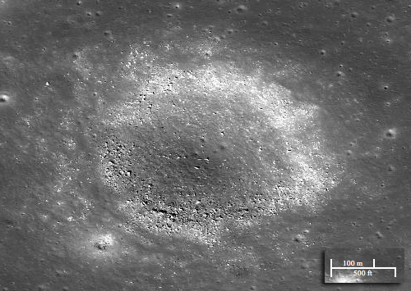
Classification Scheme
Boulders in rim of crater
(Lat,Lon): -69.82715, 44.19792
Boulders in and out of crater
(Lat,Lon): 70.05710, 33.74692
Boulders in crater
(Lat,Lon): -57.83154, 27.59439
ASU/LROC/ACT

Slide 8
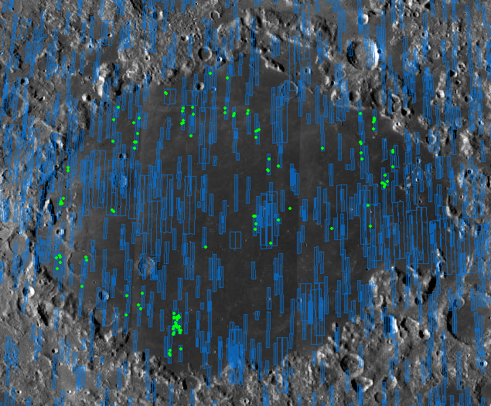
Distribution
NAC footprints in blue
Bouldery craters in green
Craters are mainly grouped together.
There are gaps in NAC coverage of Mare Crisium.
100 km
ASU/LROC/ACT

Slide 9
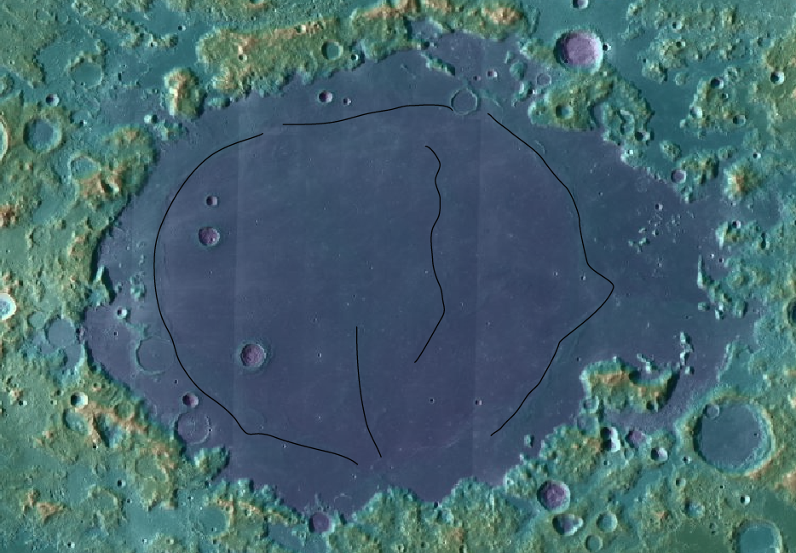
Flow features
Lava Flow features are outlined
These are areas of higher elevation
100 km
ASU/LROC/ACT

Slide 10
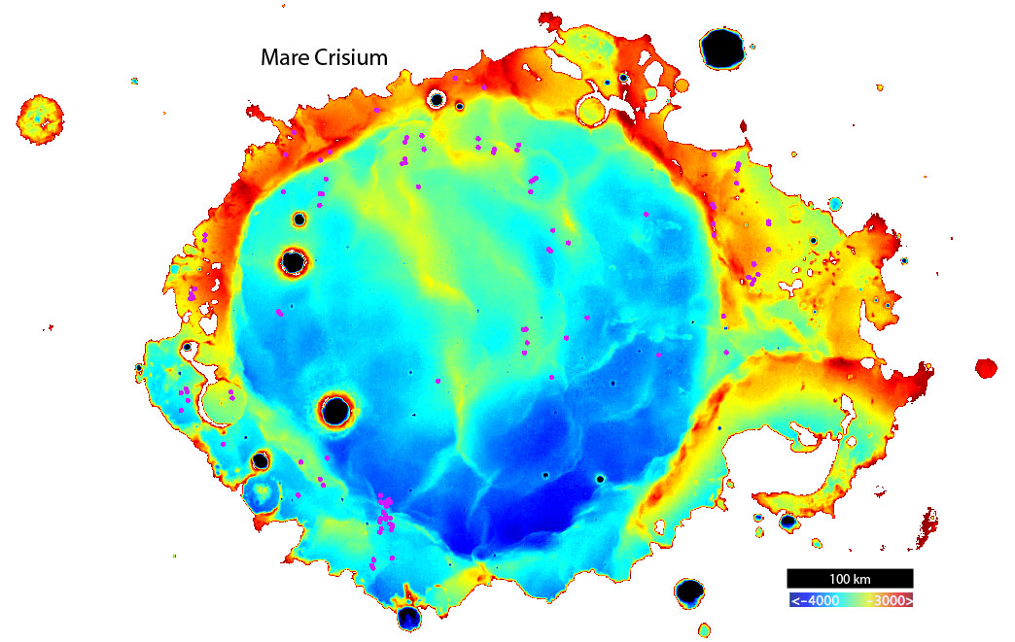
Elevation Map
Craters can be found predominantly in areas of higher terrain.
Source: NASA/LROC/ASU

Slide 11
Results
120 craters found
Boulders in crater were the most common class
A: Boulders in rim (34)
B: Boulders in and out of crater (38)
C: Boulders inside crater (48)
No consistent correlation seen between crater type and location.
Craters are found primarily around the rim of Mare Crisium and one linear grouping from north to south through center.
This matches LOLA DEM showing several different flow events in Crisium.

Slide 12
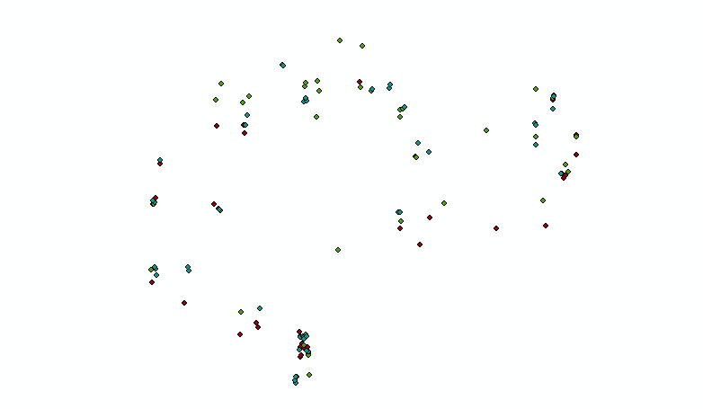
Isolated Distribution
Green= A. inside and outside of crater
Red=B. in rim of crater
Blue=C. inside crater
100 m
ArcGIS

Slide 13
Conclusion
Craters are in regions of higher elevation with probable thinner mare flows.
The next step is a topographic study with high resolution Digital Terrain Models.
By studying additional mare units will be able to possibly find the cause of classification type.

Slide 14
Sources
Burgess, R., and G. Turner, Laser ⁴⁰Ar-³⁹Ar age determination of
Luna 24 mare basalts, Meteorit. Planet Sci., 33(4), 921-935, 1998.
Feldman, W. C., O. Gasnaut, S Maurice, D. J. Lawrence, R. C.
Elphic, P. G. Lucey, and A. B. Binder, Global distribution of lunar composition: New results from Lunar Prospector, J Geophys. Res., 107(E3), 5016, doi:10.1029/2001JE001506, 2002.
Heisinger, H., R. Jaumann, and J.W. Head III, Ages of mare
basalts on the lunar nearside. J. Geophys. Rev., 105, 29,239-29,275, 2000.
Heisinger, H., J.W. Head III, U. Wolf, R. Jaumann, and G. Neukum, Ages and stratigraphy of bare basalts in Oceanus Procellarum, Mare Nubium, Mare Cognitum, and Mare Insularum. J. Geophys. Rev., 105, 2000.
Robinson, M. R. et al., Lunar Reconnaissance Orbiter Camera (LROC) Instrument Overview, Space Sci. Rev., 150, 81-124 DOI: 10.1007/s11214-010-9634-2
Schultz, P. H., Greeley, R., and Gault, D. E., Degredation of small mare surface features. Lunar Science Conference, 7th, Houston, Tex., March 15-19, 1976, Proceedings. Volume 1. (A77-34651 15-91) New York, Pergamon Press, Inc., 1976, p. 985-1003.

Slide 15
Questions?

Slide 16
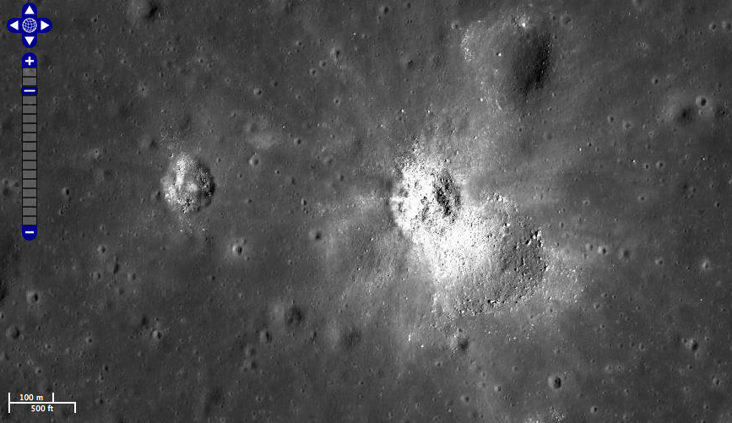
Classification
Fresh mare crater NASA/ASU/LRO

